Slide 1

DAX Explained Through Dance, Memes and Dad Jokes
Barney Lawrence
@SQLBarney
github.com/BarneyLawrence/Sessions-DAX-Through-Dance
Notes:
Start 0 mins – 4 mins – Finish 4 mins

Slide 2






About Me

Slide 3
Dance

Slide 4


Dad
Daddy is funny
…but his jokes aren’t

Slide 5
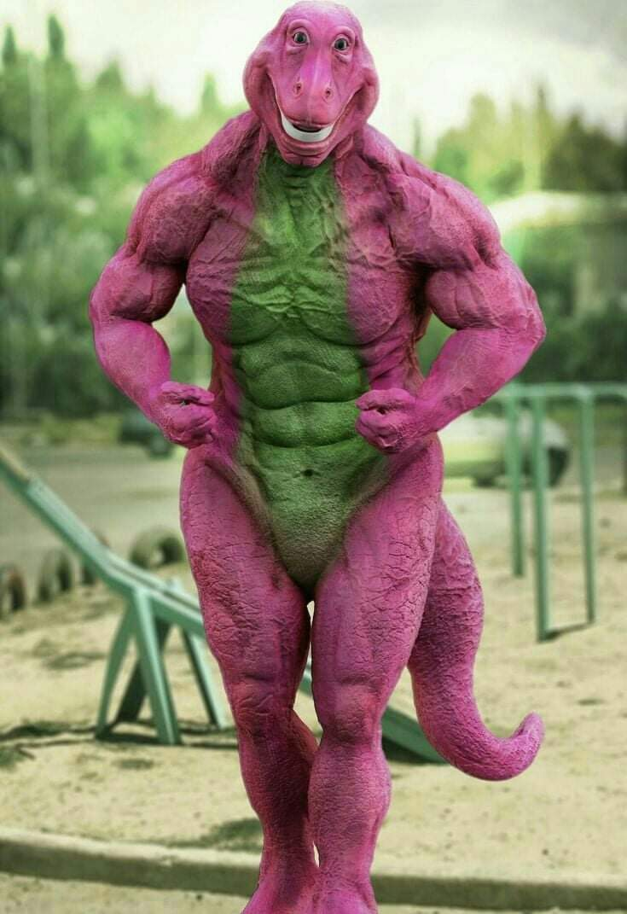
Memes

Slide 6


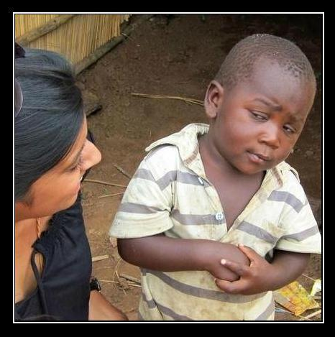

What?!
Notes:
Start 4 mins – 6 mins – Finish 10 mins Why am I doing this?

Slide 7

Learning DAX Stage 1
Notes:
Not too long

Slide 8

Learning Dax Stage 2
Notes:
Not too long

Slide 9
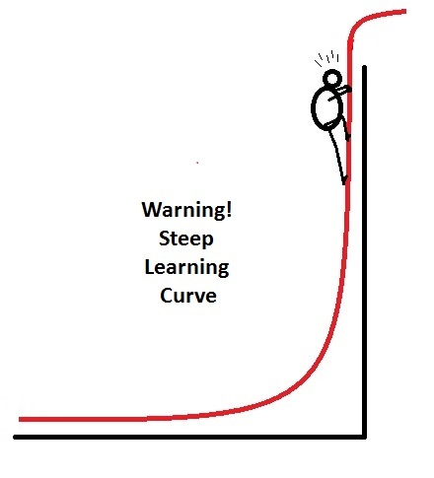
Learning Dax Stage 3
Notes:
Not too long Pause for the dog

Slide 10

Shih-Tzu
Photo by Edson Torres on Unsplash

Slide 11
Key Points
Filter Context
Row Context
Calculate and Context Transition
Calculate and Context Changes

Slide 12
A Simple Calculation
Punchline Measure 1 =
VALUES(Jokes[Punchline])
Notes:
10 mins start – 5 mins – 15 mins finish

Slide 13

Level 1
Punchline Measure 1 =
VALUES(Jokes[Punchline])

Slide 14

Level 2
Punchline Measure 2 =
IF(
COUNT(Jokes[Punchline]) = 1,
VALUES(Jokes[Punchline]),
"Too Many Answers"
)

Slide 15

Level 3
Punchline Measure 3 =
IF(
HASONEVALUE(Jokes[Punchline]),
VALUES(Jokes[Punchline]),
"Too Many Answers"
)

Slide 16

Level 4
Punchline Measure 4 =
SELECTEDVALUE(
Jokes[Punchline],
"Too Many Answers"
)

Slide 17
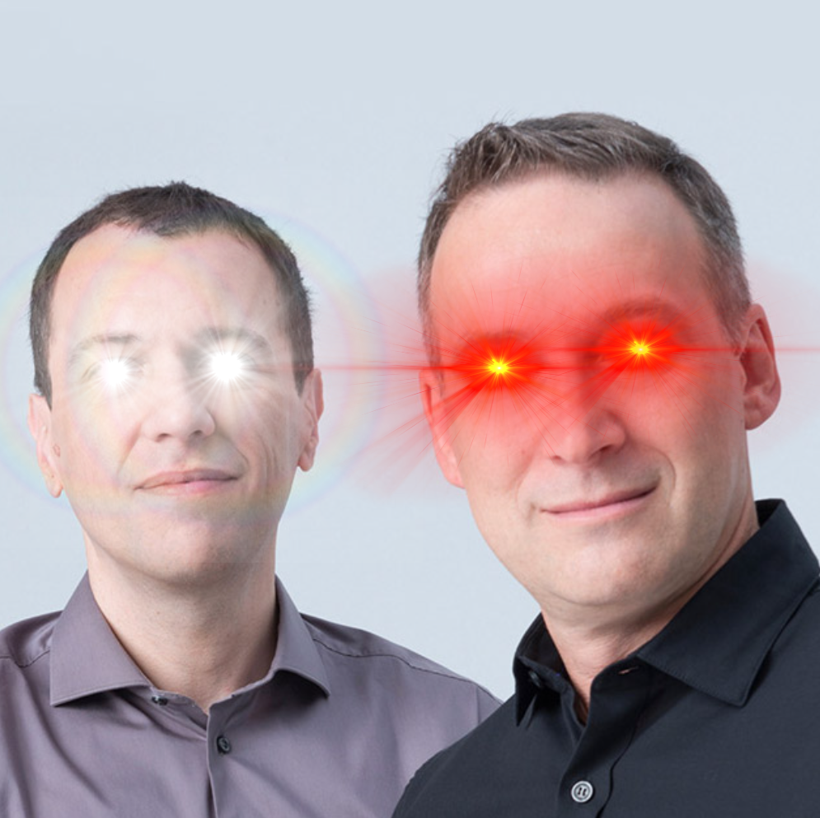
Level 5
Punchline Measure 5 =
CONCATENATEX(
Jokes,
Jokes[Punchline],
", "
)

Slide 18
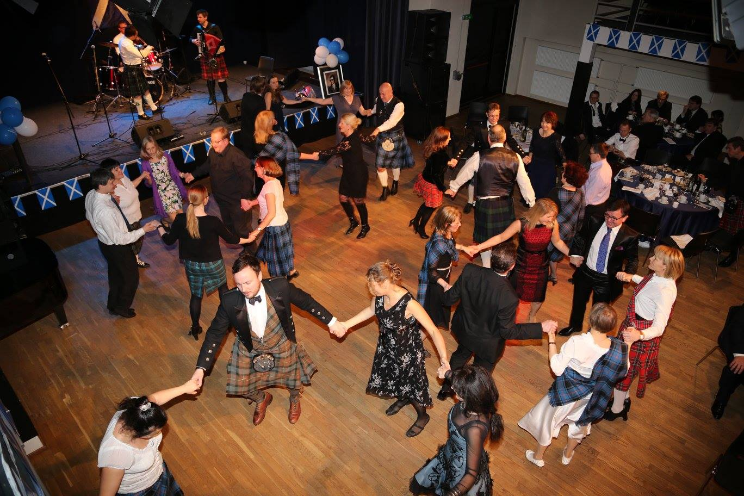
Filter Context
Notes:
15 mins start – 4 mins – 19 mins finish

Slide 19
Example 1
Couple | Value 1 | Value 2
Couple 1 | 2 | 1
Couple 2 | 2 | 1
Couple 3 | 2 | 1
SUM(Value1 x Value2)
=Error
Notes:
19 mins start – 2 mins – 21 min finish

Slide 20
Example 1
Couple | Value 1 | Value 2
Couple 1 | 2 | 1
Couple 2 | 2 | 1
Couple 3 | 2 | 1
SUM(Value1) x SUM(Value2)
=(2 + 2 + 2) x (1 + 1 + 1)
=18

Slide 21
Introducing SUMX
SUMX (Table, Expression)
SUMX(
Dancers,
Dancers[Value 1]*Dancers[Value 2]
)
Notes:
21 mins start – 3 mins – 24 mins finish

Slide 22
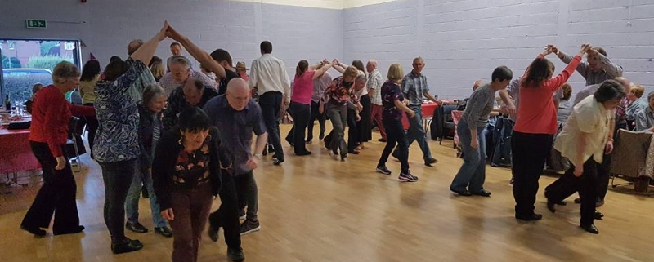
Row Context

Slide 23


Dance 1

Slide 24
Dance 1
= (2 x 1)

Slide 25
Dance 1
= (2 x 1)
+ (2 x 1)
+ (2 x 1)
=6

Slide 26
Example 2
Measure 2 = SUMX(
Dancers,
SUM(Dancers[Value 1])*SUM(Dancers[Value 2])
)
Notes:
24 mins start – 2 mins – 26 finish

Slide 27
Guess The Result
6 (2x1 + 2x1 + 2x1)
18 (2+2+2) x (1+1+1)
Something Else

Slide 28

The Answer
54
6
18

Slide 29


An Explanation
Notes:
26 mins start – 4 mins – 30 min finish

Slide 30
(2+2+2) x (1+1+1)
Row 1
=18
=0
Value 1 - Value 2

Slide 31
(2+2+2) x (1+1+1)
+(2+2+2) x (1+1+1)
Row 1
Row 2
=36
=18
Value 1 - Value 2

Slide 32
(2+2+2) x (1+1+1)
+(2+2+2) x (1+1+1)
+(2+2+2) x (1+1+1)
Row 1
Row 2
=54
=36
Row 3
Value 1 - Value 2

Slide 33


Slide 34
Example 2 - Fixed
Measure 2 = SUMX(
Dancers,
CALCULATE(
SUM(Dancers[Value 1])*SUM(Dancers[Value 2])
)
)
Notes:
30 mins start – 2 mins – 32 mins finish

Slide 35

You get a filter context
You get a filter context
You get a filter context
Calculate()
You get a filter context
You get a filter context
You get a filter context

Slide 36
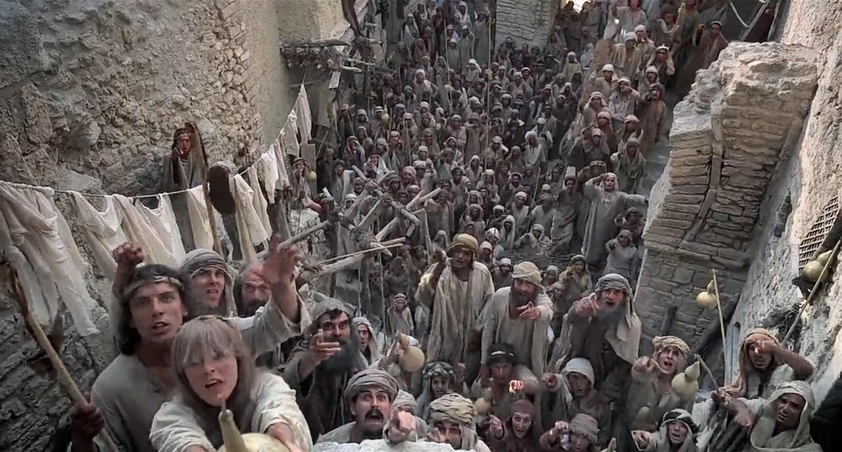
We’re all different!
I’m Not!

Slide 37
Example 2 – Part 2
Couple | Value 1 | Value 2
Olivia | 2 | 1
Olivia | 2 | 1
Amelia | 2 | 1
Notes:
32 mins start – 3 mins - 35 min finish

Slide 38

(2+2) x (1+1)
Value 1 - Value 2

Slide 39



(2+2) x (1+1)
+(2) x (1)
=8
Value 1 - Value 2

Slide 40
(2+2) x (1+1)
+(2) x (1)
+(2+2) x (1+1)
=10
=18
Value 1 - Value 2
Notes:
Pause for next slide.
Finish 35 mins. Skip next 3 slides if over time.

Slide 41

Why Not Pre-Calculate Value 1 x Value 2 in the Table?
Notes:
35 mins start – 3 mins – 38 min finish

Slide 42


Slide 43
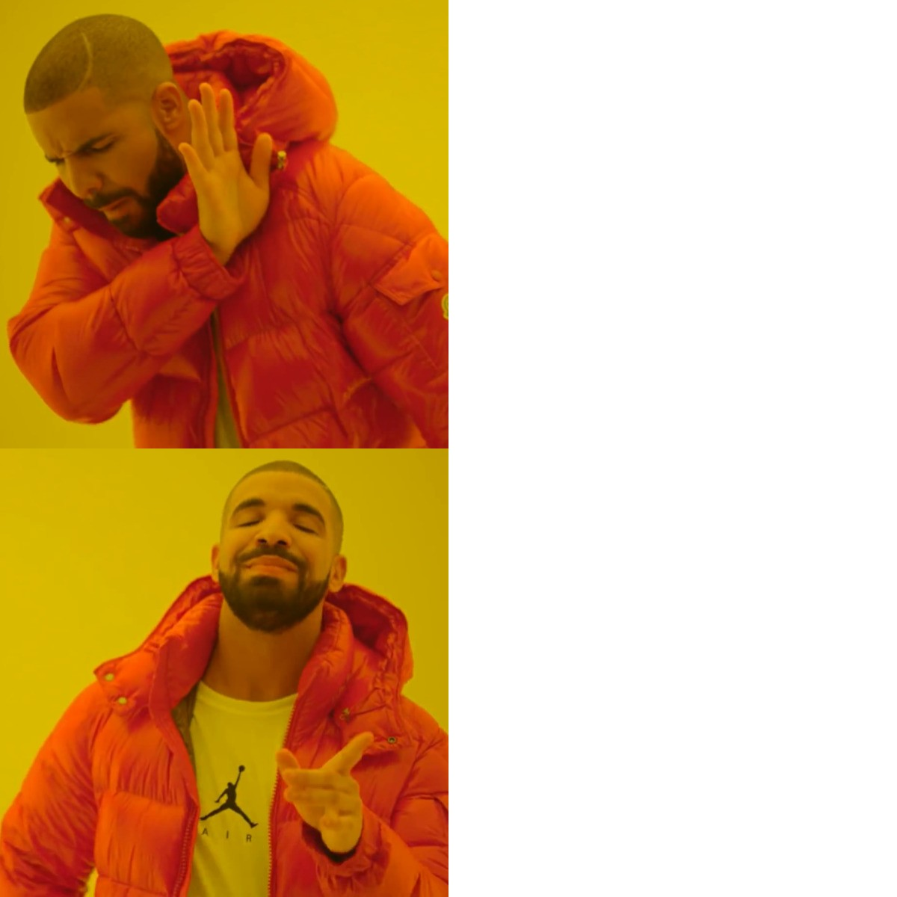


Roche’s Maxim of Data Transformation
Transforming data as far downstream as necessary
Transforming data as far upstream as possible

Slide 44
Calculate
CALCULATE ( <Expression> [, <Filter> [, <Filter> [, … ] ] ] )
Notes:
38 min start – 5 mins – 43 mins finish

Slide 45
Calculate Example
Total Sales = SUM('Sales By Year'[Sales])
Red Sales =
CALCULATE(
SUM('Sales By Year'[Sales]),
'Sales By Year'[Colour] = "Red"
)

Slide 46

Original Filter Context
Calculate
New Filter Expression

Slide 47
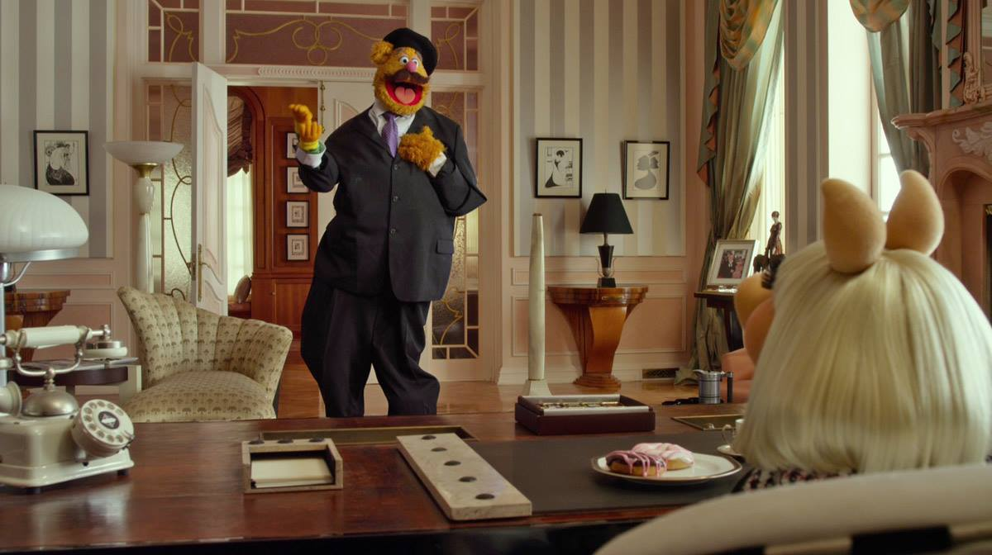
'Sales By Year'[Colour] = "Red"

Slide 48
Calculate Expanded
Red Sales =
CALCULATE(
SUM('Sales By Year'[Sales]),
FILTER(
ALL('Sales By Year'[Colour]),
'Sales By Year'[Colour] = "Red"
)
Red Sales =
CALCULATE(
SUM('Sales By Year'[Sales]),
'Sales By Year'[Colour] = "Red"
)

Slide 49
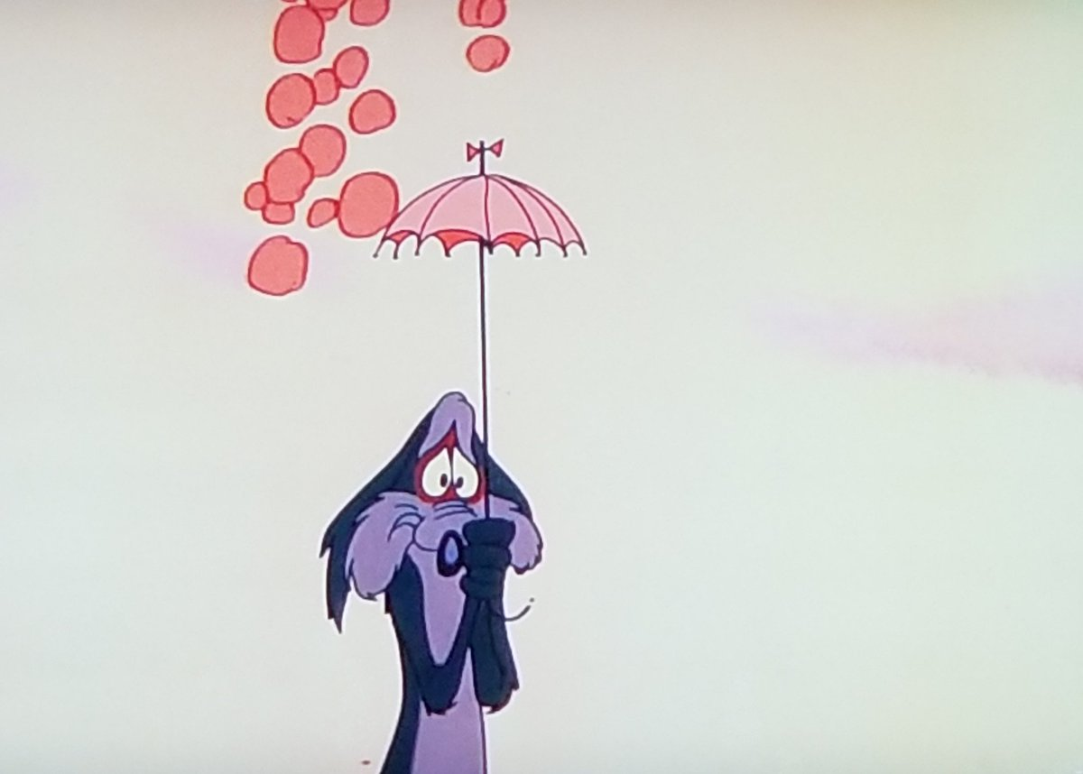
ALL

Slide 50
Original Filter Context
Calculate
New Filter Expression
Notes:
43 min start – 2 mins - 45 min finish

Slide 51
Values
Red Sales 2 =
CALCULATE(
SUM('Sales By Year'[Sales]),
FILTER(
VALUES('Sales By Year'[Colour]),
'Sales By Year'[Colour] = "Red"
)
)

Slide 52
Keep Filters
Red Sales 3 =
CALCULATE(
SUM('Sales By Year'[Sales]),
KEEPFILTERS('Sales By Year'[Colour] = "Red")
)

Slide 53
Key Points
Filter Context
Row Context
Calculate and Context Transition
Calculate and Context Changes
Notes:
45 min start – 4 mins 49 min finish
Air freshener!

Slide 54

DAX Explained Through Dance, Memes and Dad Jokes
Barney Lawrence
@SQLBarney
github.com/BarneyLawrence/Sessions-DAX-Through-Dance

Slide 55

Red Sales (PY) =
CALCULATE(
SAMEPERIODLASTYEAR([Sales]),
'Sales'[Colour] = "Red"
)
Always has been
It’s All Syntax Sugar

Slide 56

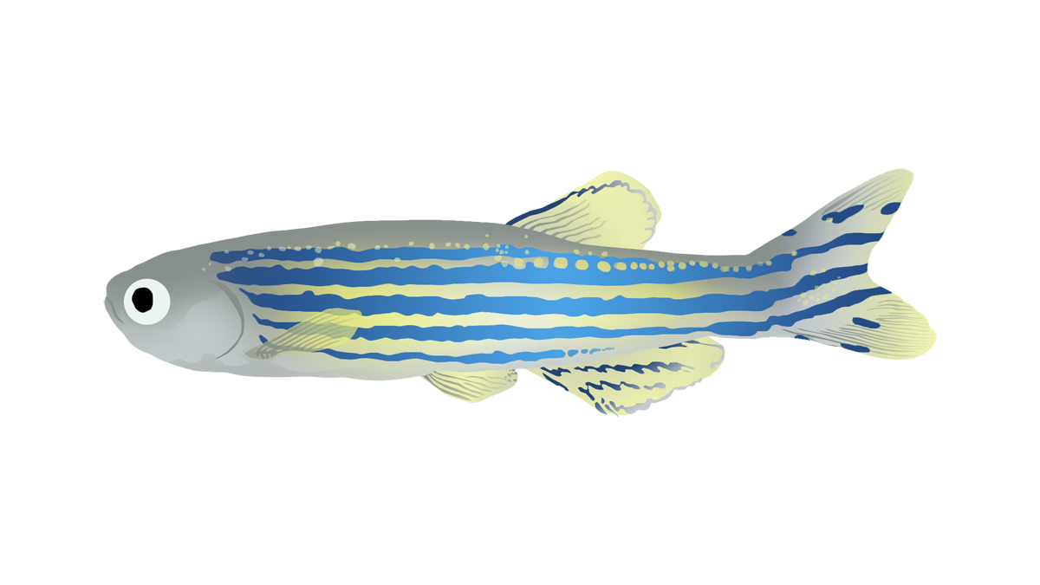

Key Influencers

Slide 57
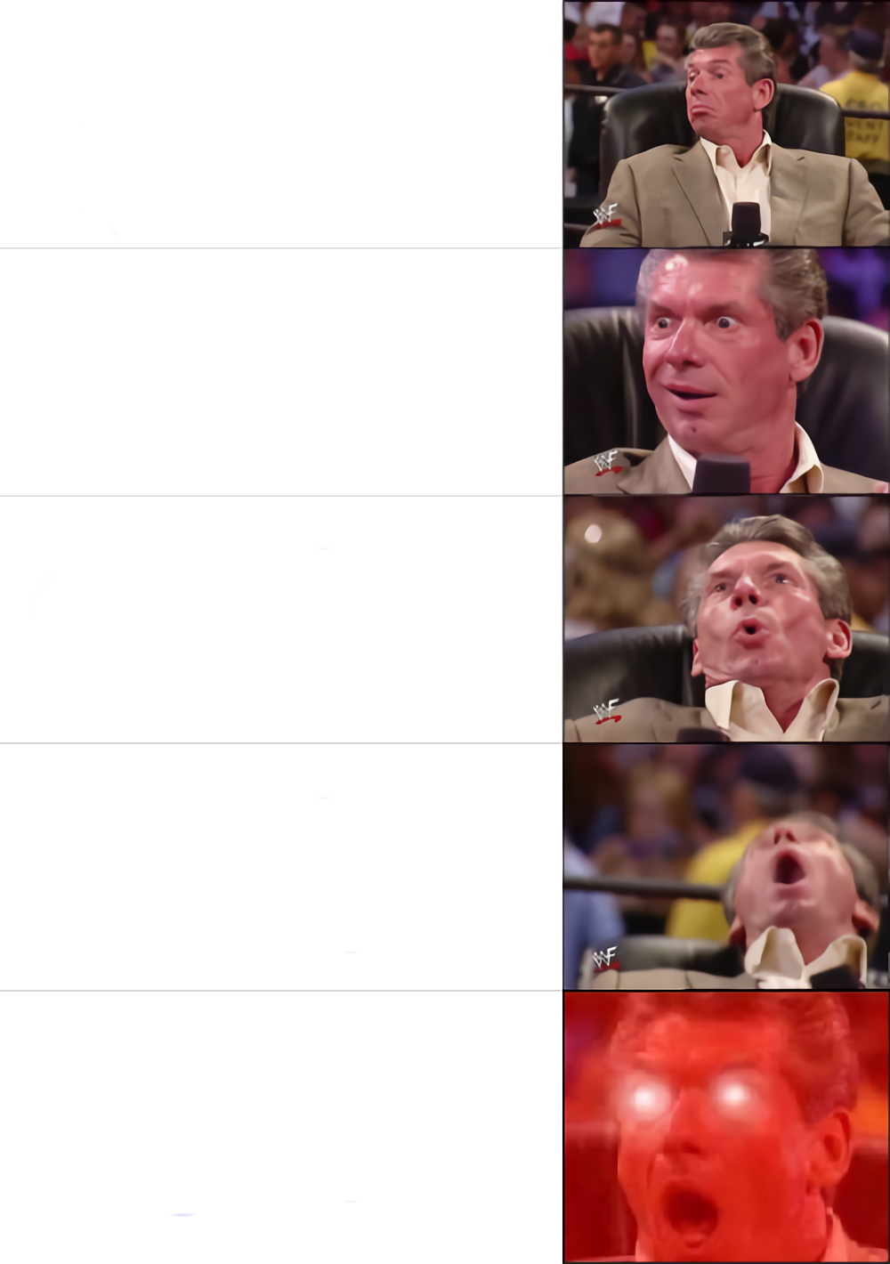
Presenting DAX Explained Through Dance, Memes and Dad Jokes
At Bletchley Park on
2nd October
With exclusive access to The National Museum of Computing
Alongside 17 other great speakers
Repeated in Reading, Bristol, Birmingham and Manchester between 3rd & 6th October

Slide 58





Sponsors – Thank you
We couldn’t do it without you.

Slide 59

DAX Explained Through Dance, Memes and Dad Jokes
Barney Lawrence
Feedback:
https://forms.gle/69nRX7FLXUkdMMjx7
github.com/BarneyLawrence/Sessions-DAX-Through-Dance

